Slide 1
Twitter Mining Fall 2017
By
Harsh Pathak
Jidapa Thadajarassiri
Krushika Tapedia
Pitchaya Wiratchotisatian
Prince Shiva Chaudhary

Slide 2
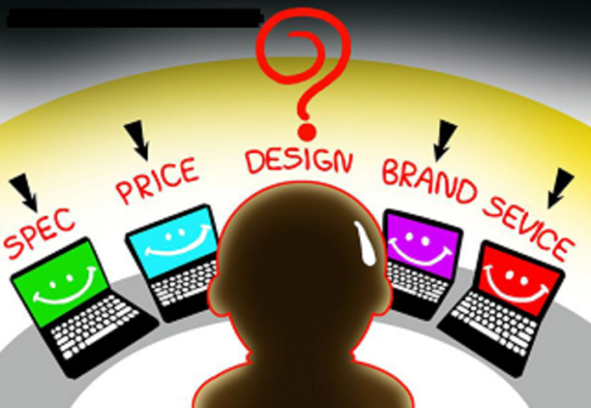
New Laptop??
Price?
Mac?
Spec?
Dell?
HP?
Surface?
Design?
Acer?
Service?
Lenovo?

Slide 3
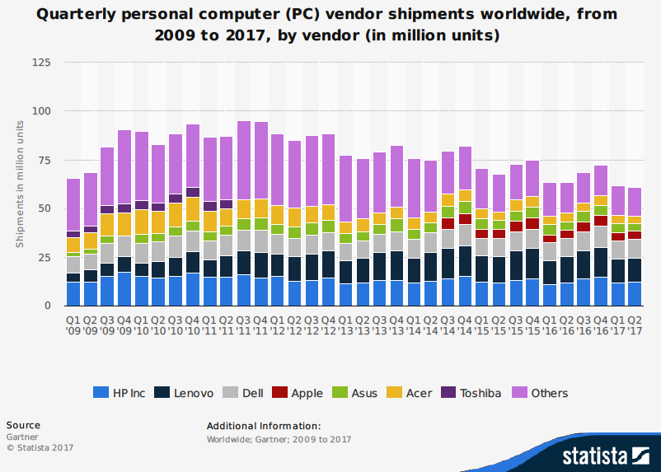
“Acer”

Slide 4
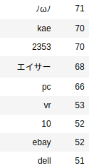
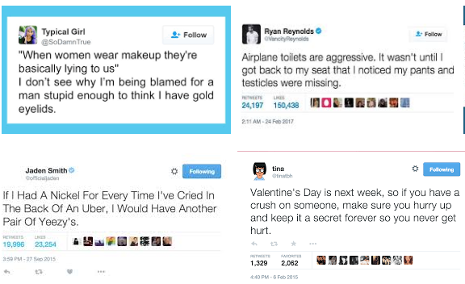
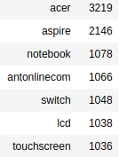
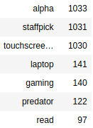
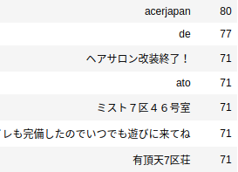
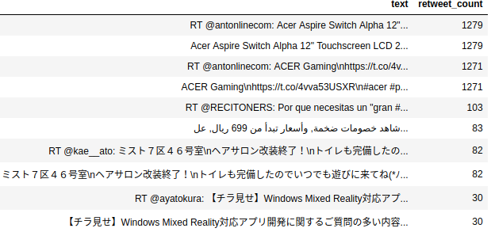
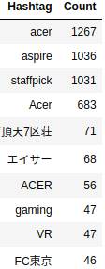
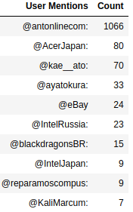
“Acer” in Twitter
Top 30 words
#acer ~ 2,000 tweets
raw data -> json
Top 10
Top 10 tweets
Hashtags User mentions

Slide 5

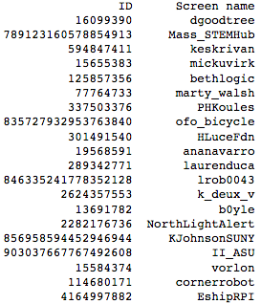
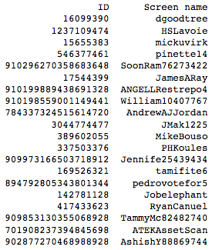
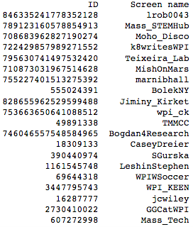
Popular Twitter User
“Laurie Leshin”
#Total Friends: 1,100
20 Friends
#Total Followers: 5,569
20 Followers
#Total Mutual friends: 550
20 Mutual Friends

Slide 6
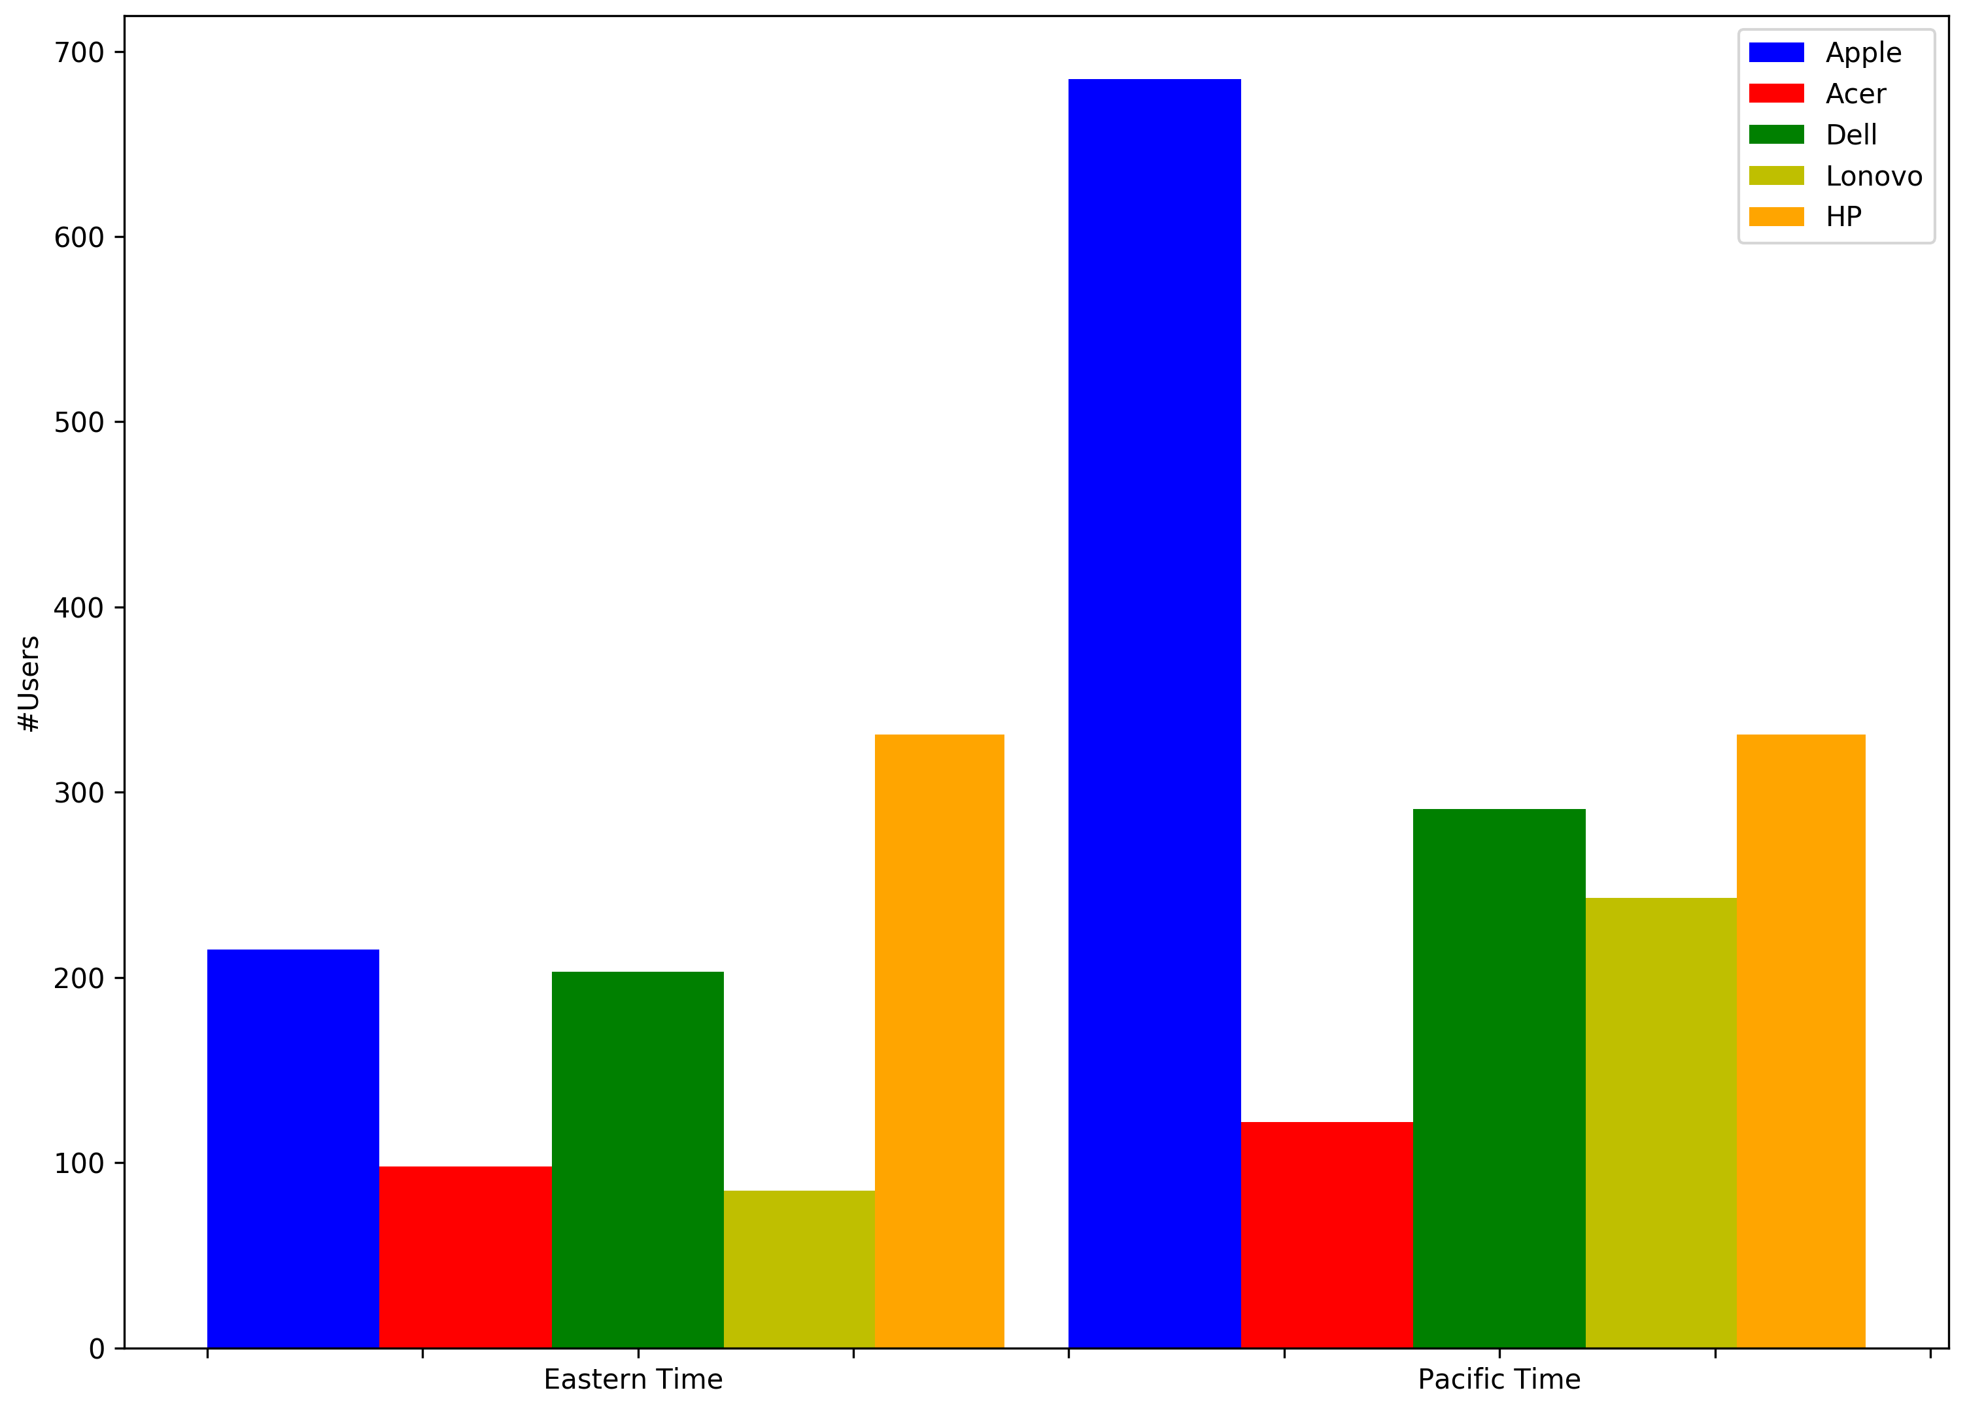
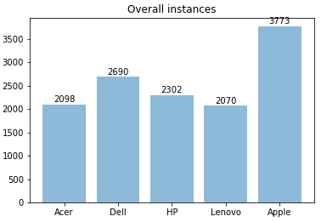
Business Questions (1/2)
Brand Awareness
How good is our brand awareness?
Customers Distribution
What is the geographic segmentation for them?
#tweets
#users
Eastern Time Pacific Time

Slide 7
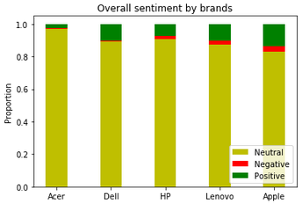
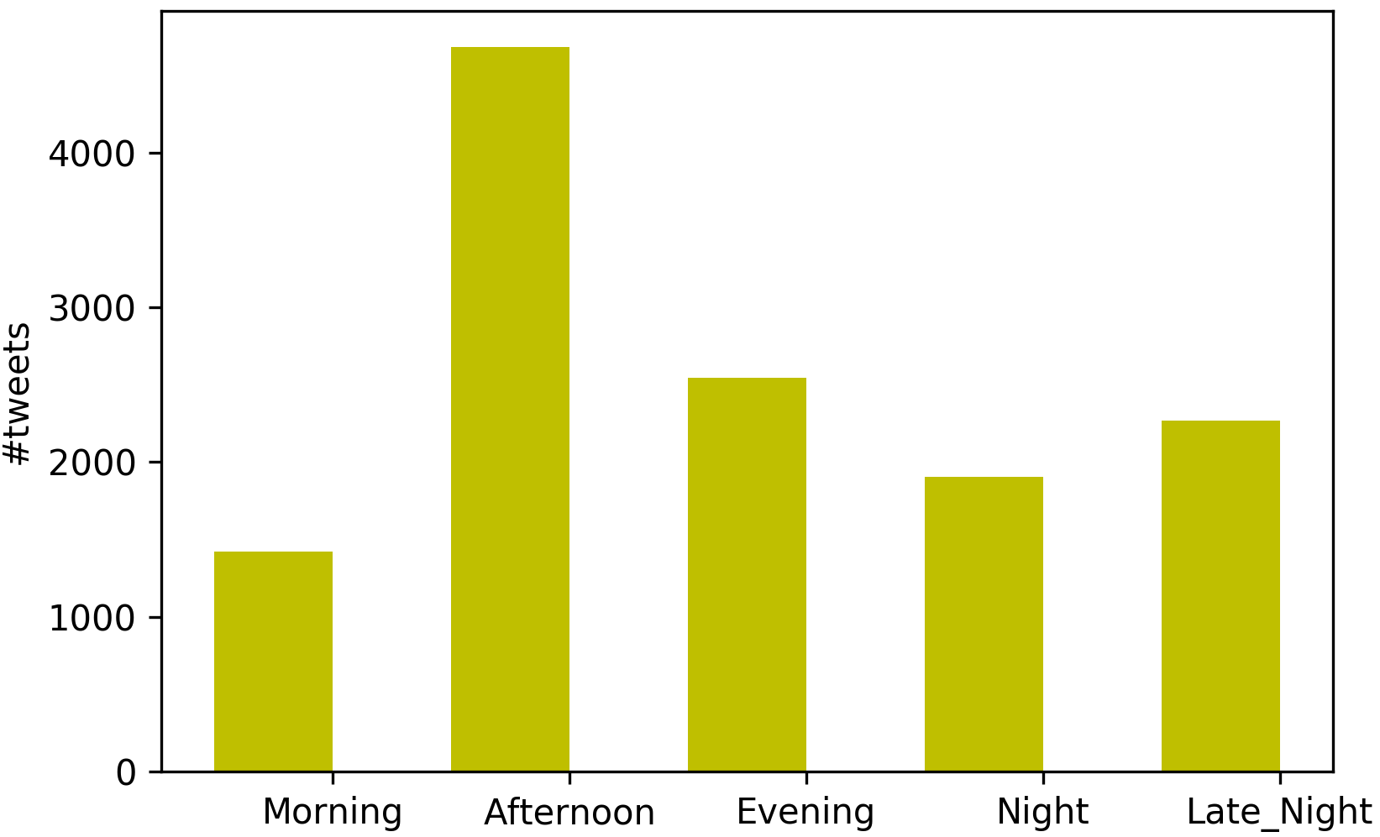

Business Questions (2/2)
Service Improvement
How do people feel about Acer?
Advertisement
What time period in a day should we release
an advertisement on twitter?
“Sentimental Analysis”
#tweets

